Slide 1

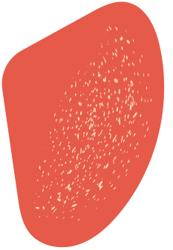



Unity
Donors
Connecting Lives Through Blood Donation

Slide 2


Developed by
Md. Khaled Bin Joha, ID: 1052.
Mikail Karim, ID: 1059.
Md. Imtiaz Hasan Bhuiyan, ID: 1062.

Slide 3

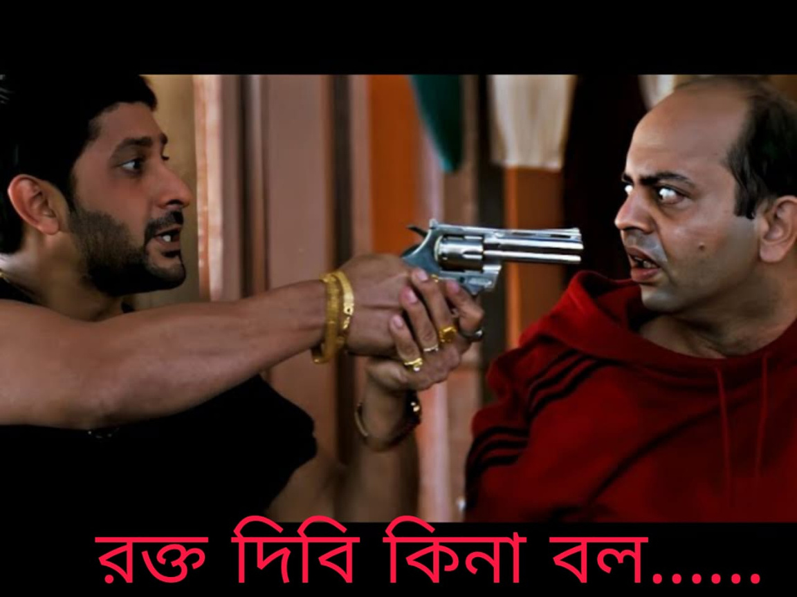
Our Motivation

Slide 4


Introduction
Unity Donors is a web-based blood donation management system designed to connect donors with recipients efficiently. It enables users to register, request blood, and find compatible donors based on blood type and location. The platform features role-based access for donors, seekers, admins, hospitals, and blood banks, along with an intelligent matching algorithm and automated email/SMS notifications for seamless communication.

Slide 5
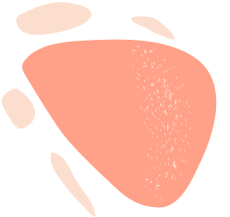

Features Overview
Automated Donor Matching – Connects donors with recipients based on blood type, location, availability, and emergency priority.
Real-time Notifications – Sends instant email/SMS alerts for blood requests, approvals, donation schedules, and urgent cases.
Role-based Access Control – Secure access for donors, recipients, hospitals, blood banks, and administrators.
Data Privacy & Security – Ensures encryption, authentication, and consent-based data sharing.
Blood Management System – Monitors blood stock levels, tracks expiration dates, and prevents wastage.

Slide 6
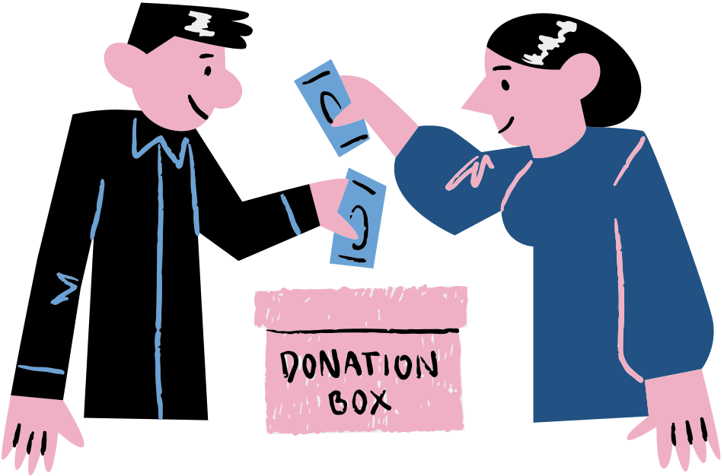
Features Overview
Volunteer Engagement – Supports donation drives, awareness campaigns, and public education.
User-friendly Interface – Simple dashboard for tracking donors, requests, and donation history.
Hospital Collaboration – Real-time blood bank coordination and a dedicated hospital portal for managing requests.
Blood Donation Campaigns – Event scheduling, social media integration, and campaign promotions.
Donor Recognition System – Awards badges, digital certificates, and rewards for frequent donors.

Slide 7
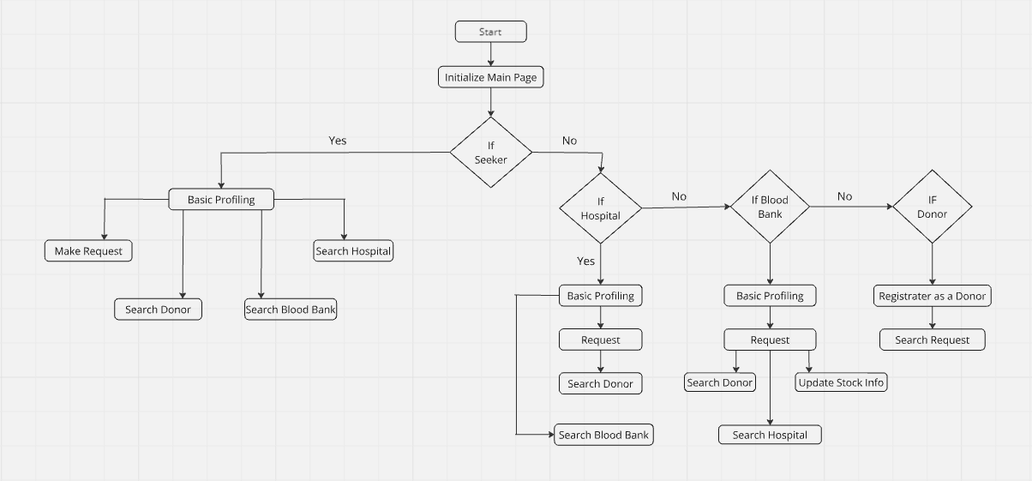
System Architecture

Slide 8
User interface screenshots

Slide 9
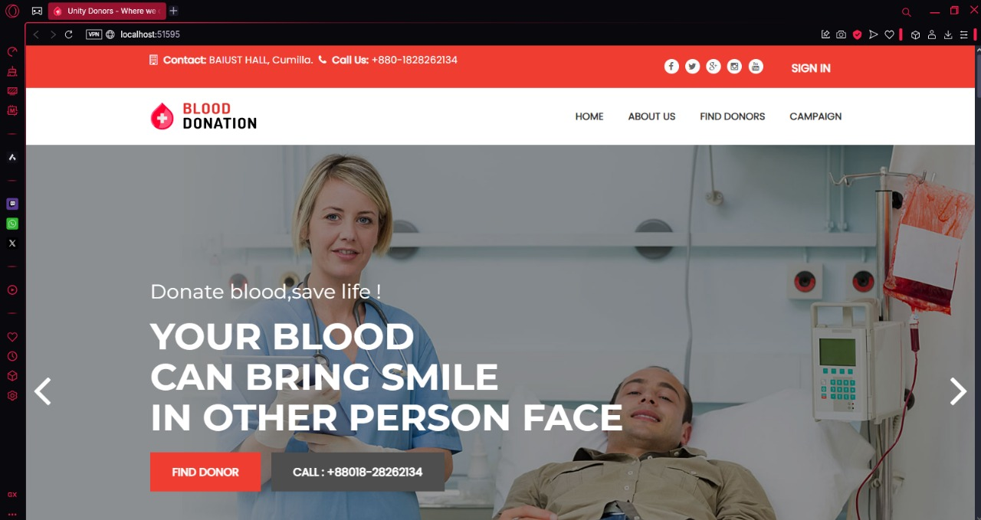
Main Dashboard

Slide 10
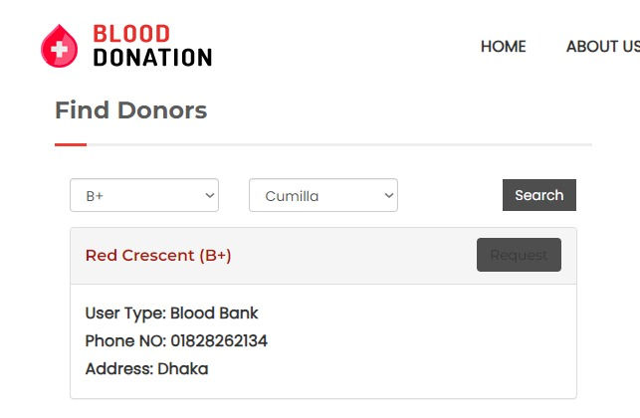
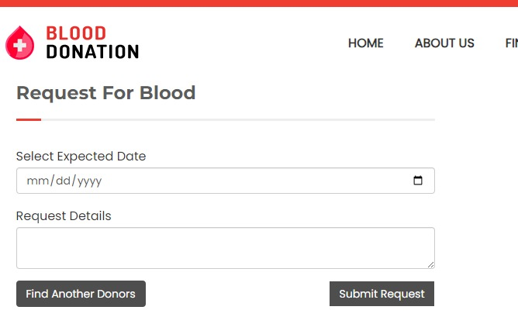
Find Donors/Bloodbank
Request form

Slide 11
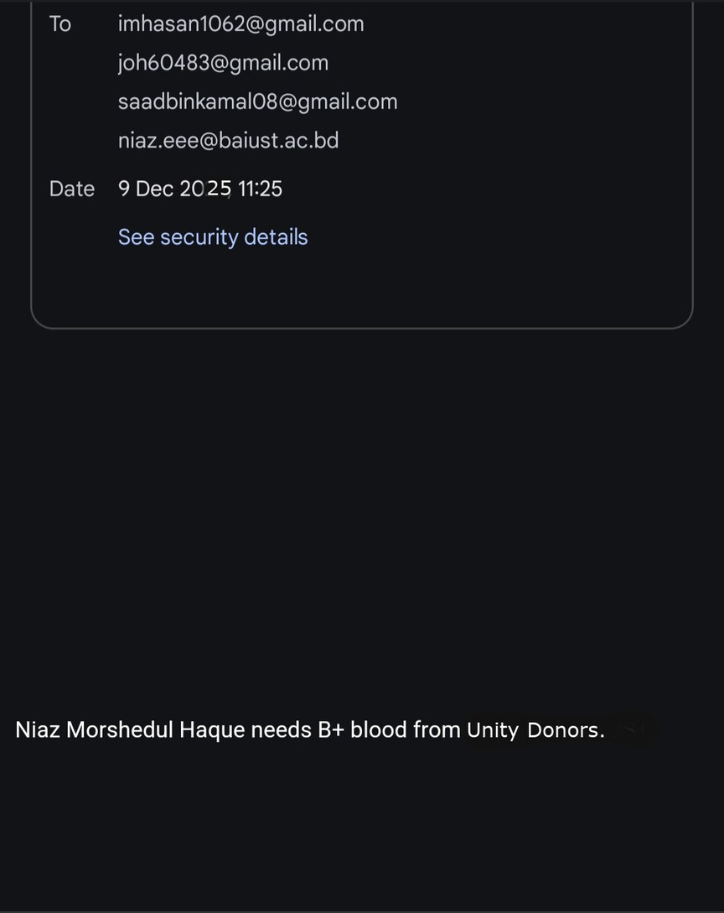
Sending email

Slide 12
Hospital requesting to Bloodbank
Bloodbank accepting the request

Slide 13
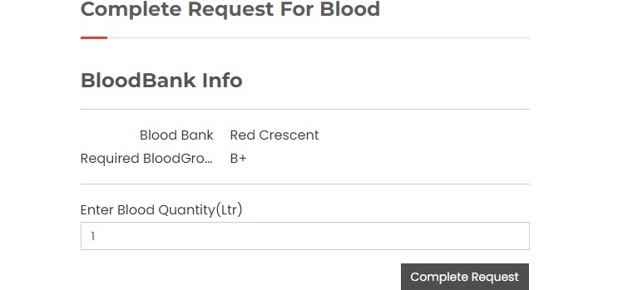
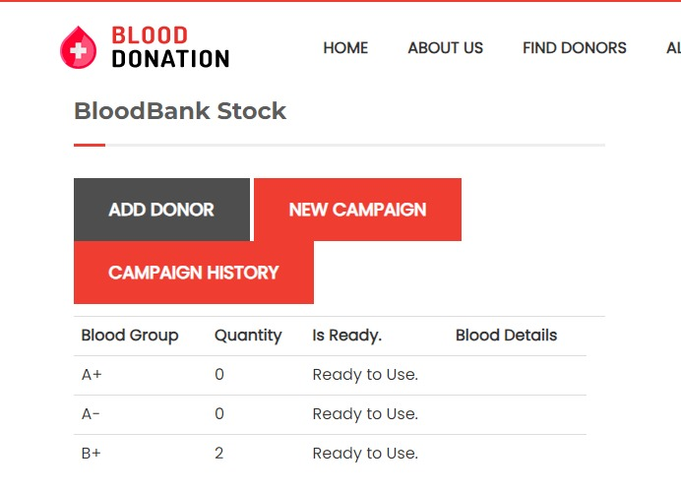
Completing request
Updating Stock

Slide 14


Challenges Faced
High latency
Donor and location matching algorithm
Email or sms sending
Real life data

Slide 15

Future Enhancements
Emergency Blood Request Feature – Activates SOS mode to notify nearby donors and coordinate transport if needed.
Advanced Donor Matching (AI-based matching)
Automated Blood Inventory Management (real-time tracking and updates of blood stock)
Mobile Application Development
Improved Verification Mechanism

Slide 16


Conclusion
Unity Donors streamlines blood donation by connecting donors, seekers, hospitals, and blood banks efficiently. With real-time tracking, automated notifications, and secure access, it ensures timely donations and improved coordination. By simplifying donor management and encouraging voluntary contributions, Unity Donors enhances healthcare accessibility and emergency response.

Slide 17
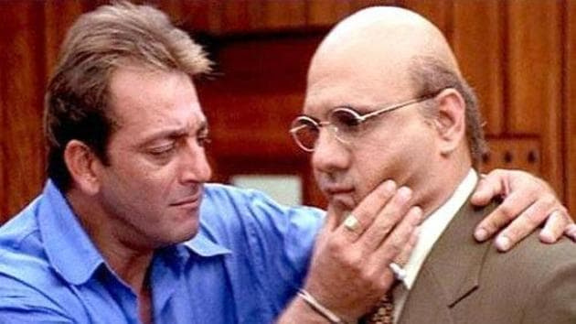
Any Questions?

Slide 18


Thank
You

